Slide 1
A High Level Design of “Discrete Sampling Geometries” and How to Create them
110th OGC Technical Committee
Singapore
Peter Trevelyan Met. Office
26 February 2019

Slide 2
Agenda
Background and Definitions.
Examples of Discrete Sampling Geometries
APIs .
Collection of DSGs into a Single Variable.
Feature Types and Use Cases.
Description of MetOcean Feature Types.
Classifying the Extraction Patterns.
Sampling Patterns.
Classifying Features by Extraction Pattern.
Summary

Slide 3
Background and Definitions:
In a MetOcean data cube each axis is discrete, i.e. it is not associated with any “continuous” coordinate or auxiliary coordinate variable.
A discrete sampling geometry (DSG) (point, time series, sections, profile or trajectory) is defined by the relationships among its spatiotemporal coordinates.
It is formed by sampling a data cube with discrete axes.
The word “axis” is used to refer to the physical interpretation of the dimensions of the data.

Slide 4
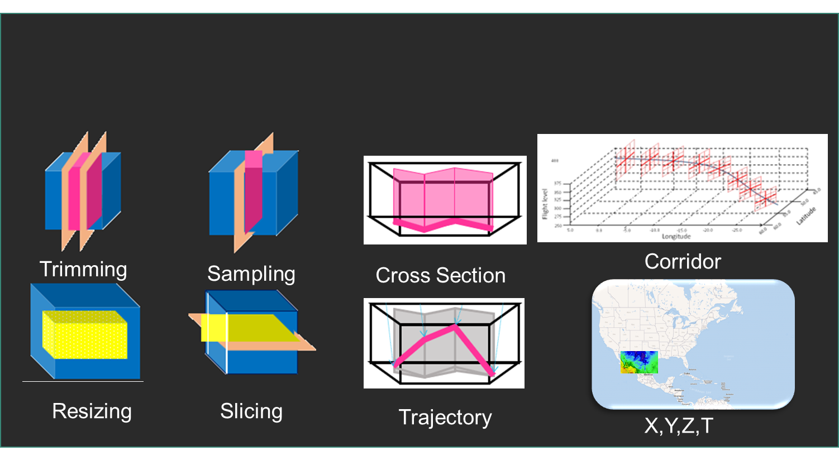
Examples of Discrete Sampling Geometries

Slide 5
Background and Definitions(2):
This talk provides an understanding of how the MetOcean community extracts information from a multi-dimensional data cube.
MetOcean “Use Cases” may be grouped by the required data DSGs.
Such examples include such data “shapes” (DSGs) e.g.:
time series,
vertical profile,
cross section etc.
Trajectories

Slide 6
Discrete Sampling Geometry
We refer to the type of DSG as its featureType.
The “featureType” (point, time series, trajectory, proﬁle, etc.) describes the DSG and speciﬁes the dimensionality of the data within the space–time domain.
The term “feature” refers herein to a single instance of the discrete sampling geometry (such as a single time series). See http://cfconventions.org/Data/cf-conventions/cf-conventions-1.7/build/ch09.html

Slide 7
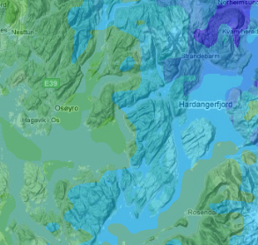
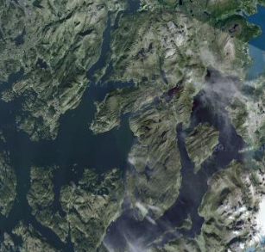
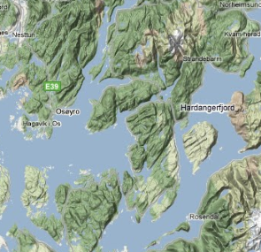

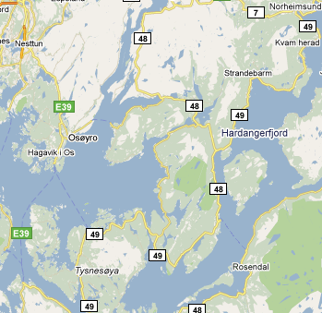



Some Typical Use Cases
Assess foundation data
MetOc
imagery
DEM
topography/
bathymetry
UAV Mission Planning
deterministic & probabilistic weather f/c with ‘confidence’ quality mask
Data capture (UAV & sensors) – integrate with predictive models
temp/pressure/ wind/precip time-series (deployed met-sensors)
temp soundings (deployed sono-bouys)
geo-rectified hi-res imagery / hi-res TIN coverage DEM
Assess overland traffic-ability for route planning,
land-usage
terrain type
soil moisture
precipitation
Assess optimal coastal landing point and time: bathymetry, winds
ocean-currents
sea-state
Tideline variation

Slide 8
Extracting Features
Each of these “Use Cases” require features that are created from a data cube by extracting data using a sampling geometry that conforms to the desired data shape (DSG).
The OGC’s “Web Coverage Service” (WCS) provides and excellent interface that supports many of the MetOcean DSGs. The MetOcean profile of the WCS2.1 extends the WCS2.1 service interface to include such shapes as polygons and trajectories.

Slide 9
APIs
WCS2 has proved to be effective and has a good uptake. Other methods of sampling are now becoming more prevalent such as the Restful APIs using the OpenAPI specification.
In order to ensure that programmatic interfaces provide the correct functionality it is useful, at a high level, to set out what these DSGs are and provide sufficient information on the requirements that the API will need to support.

Slide 10
Discrete Sampling Geometries
DSG datasets are characterized by a dimensionality that is lower than that of the space-time domain that is sampled.
An important use of discrete axes in the coverage model is to store data from a collection of DSGs into a single data variable.
The features contained within a collection must always be of the same type; and all the collections must be of the same featureType.

Slide 11
Collection of DSGs into a Single Variable
For example, a collection of time series of 1.5M air temperature at stations may be stored in a 2-D data variable with a discrete axis for the stations (the “point” axis) and another discrete axis for the instances (the “time” axis). The station positions are combined into the one discrete axis.

Slide 12
Collection of DSGs into a Single Variable
DSGs instances (aka features) may be encoded using well defined data model, e.g.:
Using the coverage implementation schema (CIS1.1. ref 09-146r6_Coverage_Implementation_Schema_CIS_1.1 ref: https://portal.opengeospatial.org/files/?artifact_id=72392&version=2
Using NetCDF
ref: https://www.geosci-model-dev.net/10/4619/2017/gmd-10-4619-2017.pdf
Using CovJSON
ref https://covjson.org/

Slide 13
Feature Types and Use Cases
Each featureType is associated with a common use case:
Some examples:-
Calculating the maximum/minimum temperature would require a time series of temperature at a point (Time Series at one point).
Detecting a “critical” vertical wind shear would require a time series of a vertical profile of wind at a point (Time Series profile at a single point).
The decision on whether not too treat roads with salt would require a forecast of temperature along a road (2D trajectory (X,Y))
Users do not often want the whole “data cube”, but a subset. This would require a sub set of the data cube created by sampling along each axis (Cube).

Slide 14
Description of FeatureTypes by AXIS/Path/Polygon
Each featureType is typified by its geospatial/temporal domain and by using this nomenclature each featureType may characterised as set out in the tables in the next slide.
1 -> Axis with one coordinate.
[1] -> Optional axis with one coordinate.
+ -> Axis with one or more coordinates.
[+] -> Optional axis with one or more coordinates.
Polygon -> A set of points in (x,y).
Trajectory or Path that may be:
2D (X,Y) Path (Simple path defined by the horizontal points)
3D (X,Y,Z) PathV (Each point in the path has a different elevation)
3D (X,Y,T) PathT (Each point in the path has a different time)
4D (X,Y,Z,T) PathVT (Each point in the path has a different time and elevation)

Slide 15
Description of MetOcean Feature Types
The Profiles, Point(s), and Cube:
DSG | Single-Location Single Time | Multi-Location Single Time | Single-Location TimeSeries | Multi-Location-TimeSeries
Point(s) | Single Point. | Collection of points. | Time Series at one point. | Point Time Series at Multiple points.
 | X=1, Y=1, Z=[1] T=1 | X=+, Y=+, Z=[1], T=1 | X=1, Y=1, Z=[1], T=+ | X=+, Y=+, Z=[1], T=+
Profiles | Single Profile. | Profile for multiple points. | Time Series profile at a single point. | Time Series profile at a multiple points.
 | X=1, Y=1, Z=+ T=1 | X=+, Y=+, Z=+, T=1 | X=1, Y=1, Z=+ T=+ | X=+, Y=+, Z=+, T=+
Cube | Single Time and Single Layer. | Single Time and Multi-Layer | TimeSeries and Single Layer. | Multi-Layer, TimeSeries
 | X=+, Y=+, Z=1, T=1 | X=+, Y=+, Z=+, T=1 | X=+, Y=+, Z=1 T=+ | X=+, Y=+, Z=+ T=+

Slide 16
Description of MetOcean Feature Types (cont)
Trajectories and Polygons
DSG | Path, Single Time | Path, each point with a single time, but different level for each point. | Path, each point with a Different Time and Same Level | Path, each point with a Different Time and Different Level
Trajectory | 2D trajectory (X,Y) | 3D trajectory (X,Y,T) | 3D trajectory (X,Y,Z) | 4D trajectory (X,Y,Z,T)
 | Z=1, T=1, Path | T=1, PathV | Z=1, PathT | PathVT
Geometry | Polygon, Single Time | Polygon time series Single Level | Polygon time series multiple-level
Polygon | Single Time Single Level | Multi Time, Single Level | Multi Time Multi Levels
 | Z=1, T=1, Poly | Z=1, T=+, Poly | Z=+, T=+, Poly

Slide 17
Description of MetOcean Feature Types (cont)
Cross Sections
The definition of a cross section is the same as that for a multipoint profile. But the reason they are separated is due to the way they are created.
Cross sections are created using a Path rather than along an axis.
DSG | 2D Path | 3D Path Each point has a different time | Time series of a profile
Cross Section | Cross section with multi-levels and one time for all points. | Cross section with multi-levels and a time dependant path | Cross Section of a profile time series.
 | Z=+, Path | Z=+, PathT | Z=+, T+, X=1, Y=1

Slide 18
Extraction Patterns
The aim of this work is to create a specific feature instance from multidimensional data cubes. The two main ways to do this are to:
Extract the data along the cube’s axes by “slicing” and “trimming”
Extract the data using a feature, e.g. trajectory/polygon
In order to create a feature instance of a specific featureType from a data cube the sampling geometry needed to create the feature instance must conform to the required featureType.

Slide 19
Extraction Patterns
Having categorised each featureType by its geospatial domain it is easy to define the shape of the “Sampling Geometry”.
Thus to create for example, a point time series, the sampled geometries would define the point and time axes.
The following slides describe each extraction pattern concurring to the DSG type. A short hand notation is used based on the axis and how the axis is sampled/discretised.

Slide 20
Classifying the Extraction Patterns.
The extraction patterns fall into one of three categories:-
Slicing/Trimming i.e axis based.
Extracting data within an area e.g. polygon
Extracting along a path e.g. trajectory

Slide 21
1: Slicing and trimming along an Axis
Slicing
Identify the axis to be sliced, by name
Need to identify the slice axis and the value of the Slice Point.
May have multiple slice points.
Trimming
Need to identify the trim method
Contains all values between lower and upper limits (subset)
Discretise the axis by defining a sample size (sample) and the upper and lower limits. This will also require an interpolation method to be defined.

Slide 22
Extraction of data along the Cube’s Axes (slicing and trimming along an Axis)

Slide 23
Slicing:
Horizontal(Slice) Point(s) (HP(S))
Points= 50.0,10.0,60.0.15.0,70.0,20.0
Vertical(Slice) Point(s) (VP(S))
Vertical Points= 50000,30000,25000,200000 (Units Pa)
Time(Slice) Point(s) (TP(S))
Time Points= 2017-05-15T00:00:00Z, 2017-05-15T12:00:00Z

Slide 24
Trimming by Sub-setting:
HorizontalSubset (HSUB)
Lower left corner, coordinate axis 1
Lower left corner, coordinate axis 2
Upper right corner, coordinate axis 1
Upper right corner, coordinate axis 2
VerticalSubset (VSUB)
Lower level, coordinate axis 1
Upper level, coordinate axis 2
TimeSubset (TSUB)
Start Time
End Time

Slide 25
Trimming by Sampling:
HorizontalSampling Parameters (HSAMP)
Lower left corner, coordinate axis 1
Lower left corner, coordinate axis 2
Upper right corner, coordinate axis 1
Upper right corner, coordinate axis 2
Coordinate axis 1 interval (requires Interpolation method)
Coordinate axis 2 interval (requires Interpolation method)
VerticalSampling Parameters (VSAMP)
First lower level coordinate
Second upper level coordinate
Coordinate axis 1 interval (requires Interpolation method)
TimeSampling Parameters(TSAMP)
Start Time
End Time
Time Interval (requires Interpolation method)

Slide 26
2: Extraction of data Within a Polygon
All data points contained within the polygon shape will be include.
More sophistication may added by including a vertical and temporal extent.

Slide 27
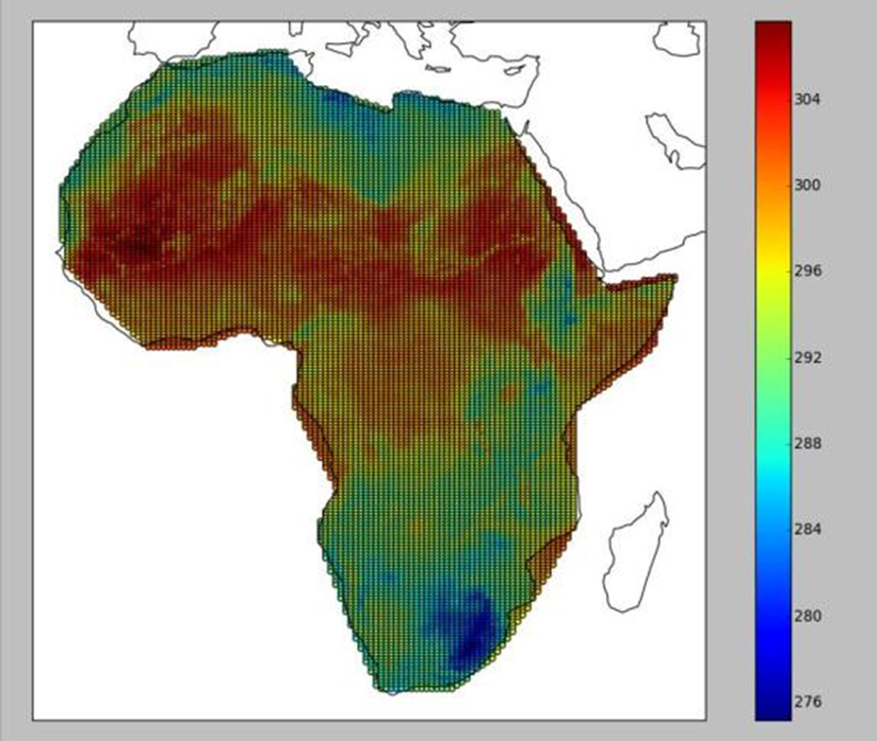
Extract the data : Polygon
This creates a featureType of Polygon

Slide 28
Extract the data Contained in a Polygon. (Feature Type Polygon)
Need to encode a Polygon as a list of x,y values:
Simple Description in X,Y (A list of points) POLY
Vertical extent may be added by specifying an upper and lower limit or a set of levels.
Time dimension may be added by specifying an upper and lower limit or a set of times.

Slide 29
3: Extraction of data Along a Trajectory/Corridor
Data from the cube is extracted along a path that is specified by its “Way Points”.
Data from the cube are interpolated in time and space depending on the dimensionality of the trajectory.
A corridor may be specified by defining a trajectory with a lateral and vertical extent.

Slide 30
Extract the data Along a FeatureType: Trajectory
This creates a feature type of Trajectory
375
350
Flight Level
325
50.0
300
Latitude
275
55.0
250
5.0
0.0
-5.0
-10.0
-15.0
-20.0
-25.0
60.0

Slide 31
Extract the data Along a Feature: Trajectory
Need to encode a multidimensional Path:
A 2D trajectory (X,Y) (PATH)
A 3D trajectory (X,Y,Z) (PATHV)
A 3D trajectory (X,Y,T) (PATHT)
A 4D trajectory (X,Y,Z,T) (PATHVT)

Slide 32
Sampling Patterns
The following slides categorise the “Sampling Geometries” for each of the featureType(s)
These geometries (including time) are encoded using the abbreviated notation.
These sampling geometries will need to be supported by whatever API is used.

Slide 33
Classifying Features by Extraction Pattern
AXIS based extraction patterns
Sampling Pattern | Single-Location Single Time | Multi-Location Single Time | Single-Location TimeSeries | Multi-Location-TimeSeries
Point(s) | Single Point. | Collection of points. | Time Series at one point. | Point Time Series at Multiple points.
 | TP, HP, [VP] | TP HPS ,HSUB, HSAMP, [VP] | TPS, TSUB, TSAMP HP, [VP] | TPS, TSUB, TSAMP HPS, HSUB, HSAMP, [VP]
Profiles | Single Profile. | Profile for multiple points. | Time Series profile at a single point. | Time Series profile at a multiple points.
 | TP, HP, VPS, VSAMP, VSUB | TP, HPS ,HSUB, HSAMP, VPS,VSAMP,VSUB | TPS, TSUB, TSAMP HP, VPS, VSAMP, VSUB | TPS, TSUB, TSAMP HPS ,HSUB, HSAMP, VPS ,VSAMP, VSUB
Cube(s) | Single Time and Single Layer. | Single Time and Multi-Layer | TimeSeries and Single Layer. | Multi-Layer, TimeSeries
 | TP, HSUB, VP, | TP, HSUB, VPS, VSAMP, VSUB | TPS, TSUB, TSAMP, HSUB VP | TPS,TSUB,TSAMP, HSUB, HSAMP, VPS, VSAMP, VSUB

Slide 34
Classifying Features by Extraction Pattern (cont)
Path/Feature based extraction patterns
Geometry | Path, Single Time | Path, each point with a single time, but different level for each point. | Path, each point with a Different Time and Same Level | Path, each point with a Different Time and Different Level
Trajectory | 2D trajectory (X,Y) | 3D trajectory (X,Y,T) | 3D trajectory (X,Y,Z) | 4D trajectory (X,Y,Z,T)
 | TP, Path | TP, PathV | TP, PathT | PathVT
Geometry | Polygon, Single Time | Polygon time series Single Level | Polygon time series multiple-level
Polygon | Single Time Single Level | Multi Time, Single Level | Multi Time Multi Levels
 | TP, Poly [VP] | TPS, TSUB, TSAMP Poly, [VP] | TPS, TSUB, TSAMP Poly, VPS,VSAMP,VSUB

Slide 35
Description of MetOcean Feature Types (cont)
Cross Sections
The definition of a cross section is the same as that for a multipoint profile. But the reason they are separated is due to the way they are created.
Cross sections are created using a Path rather than along an axis.
DSG | 2D Path | 3D Path Each point has a different time | Time series of a profile
Cross Section | Cross section with multi-levels and one time for all points. | Cross section with multi-levels and a time dependant path | Cross Section of a profile time series.
 | VPS,VSAMP,VSUB Path | VPS,VSAMP,VSUB PathT | VPS,VSAMP,VSUB, TPS, TSUB, TSAMP, TP, HP

Slide 36
Summary
This presentation describes at a high level the requirements needed of an API that his used to extract MetOcean features.
The underplaying data model is that of a Multi-Dimensional data cube with discrete axes.
An example of such an API is the OGC’s WCS2.1 with the MetOcean extensions.

